Slide 1

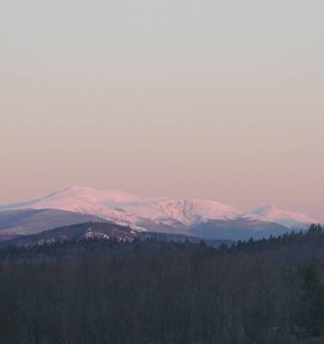
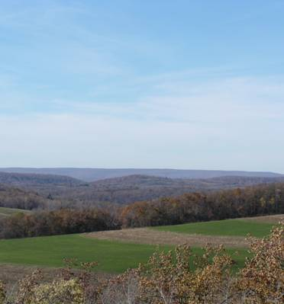


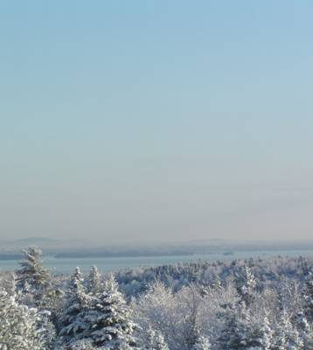

Recent MANE-VU Projections of Visibility for 2018
Gary Kleiman
MANE-VU Stakeholder Briefing
April 4, 2008
BWI

Slide 2
Presentation Overview
Provide context/overview of past modeling
Explain how measures being discussed by MANE-VU states were represented in the modeling
Provide new data showing the latest 2018 visibility projections

Slide 3
Context

Slide 4
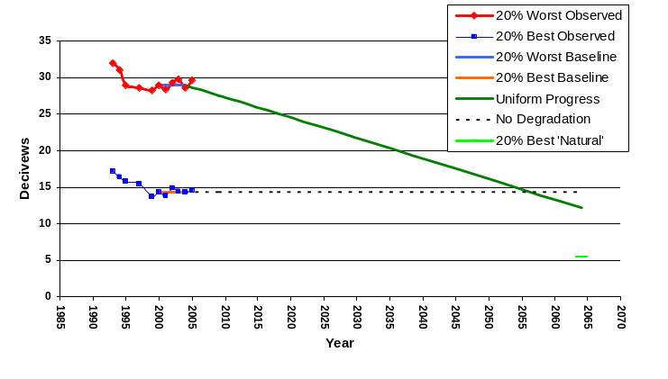
Brigantine Glide Path
1. The rule requires that states develop goals and plans that achieve “reasonable”
progress toward estimated natural conditions (measured in dv) by 2064 at Class I Sites

Slide 5
Reasonable Progress Goals
The goals are to be based on an assessment of measures with respect to:
  Cost of compliance
  Time necessary for compliance
  Energy and other non-air quality environmental impacts
  The remaining useful life of sources subject to the measures

Slide 6
Assessment Process
Measures were identified
Four Factor Analysis was performed
Emissions reductions were quantified via the various inventories that have been developed
Modeling has been conducted to assess visibility benefits of various combinations of measures within MANE-VU and in neighboring RPOs

Slide 7
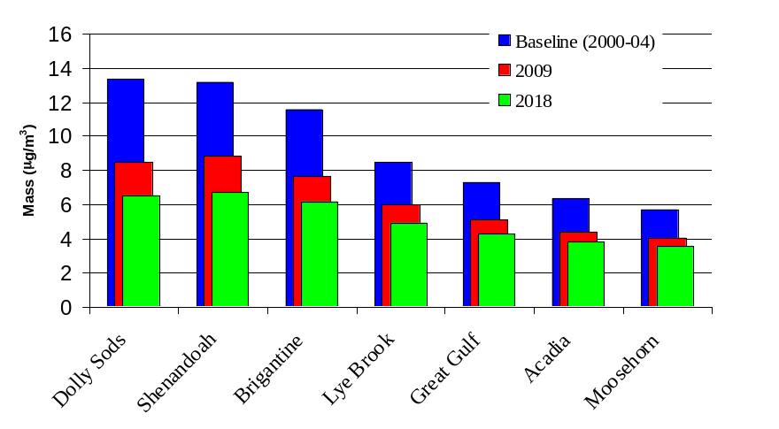
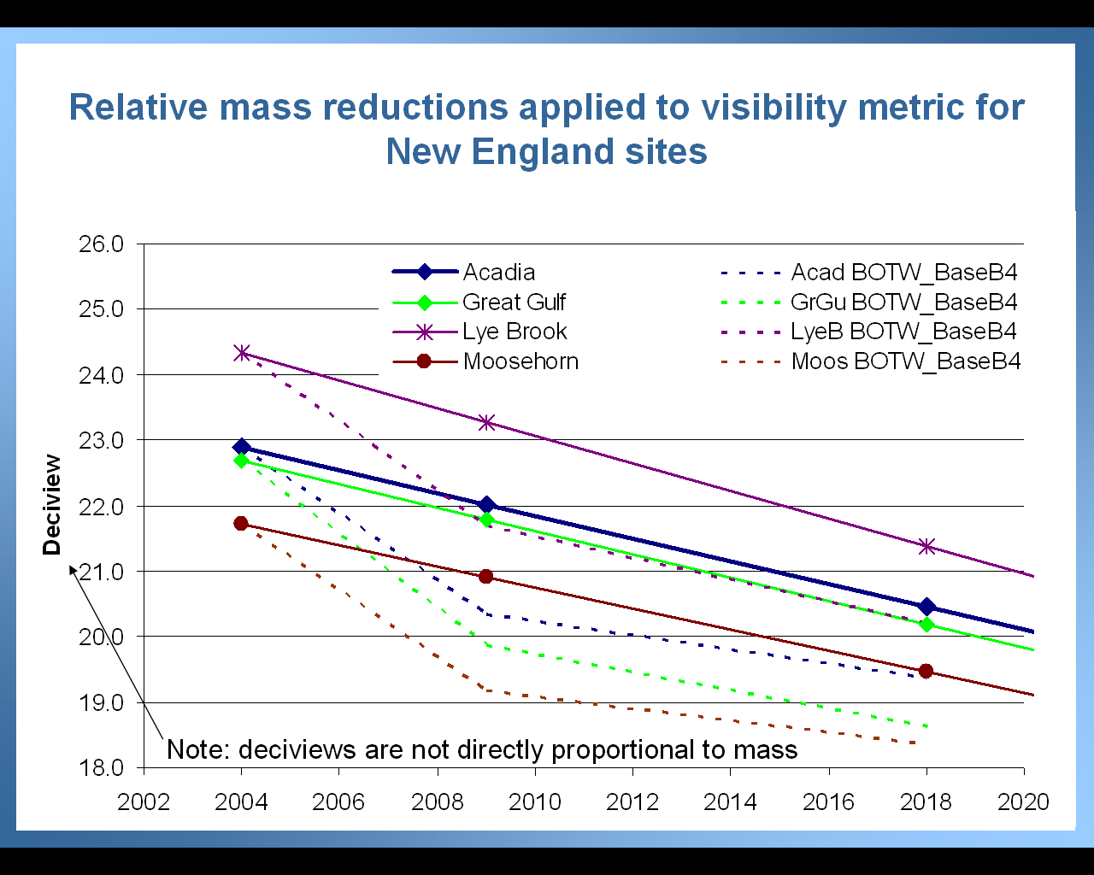
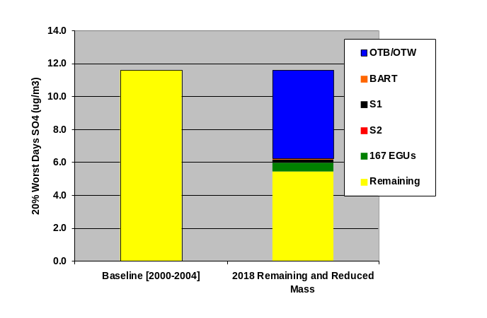
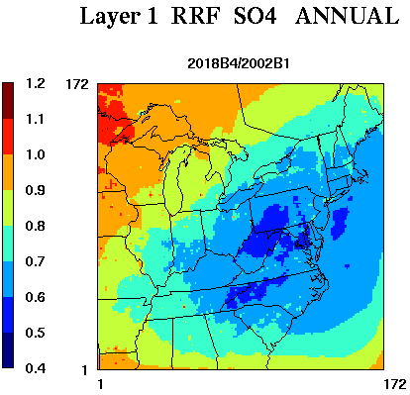
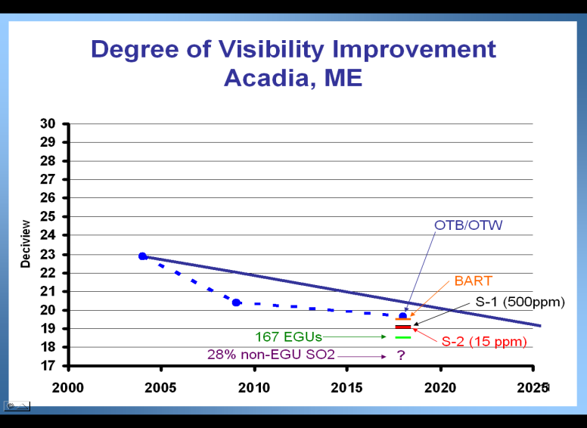
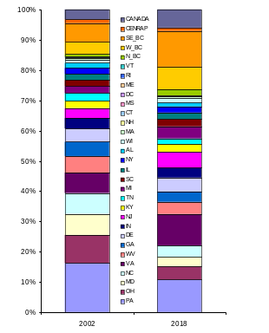
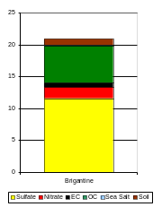
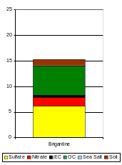
Previous Modeling
“BOTW” from Ozone SIP work
Sensitivity Modeling of
Select Measures
Attribution work for 2002 and 2018

Slide 8
Goal Today
Explain the measures that were included in the new modeling being presented
Explain how the measures were represented in the models
Present the results of the new modeling so that Class I states have an additional scenario to consider as they set Reasonable Progress Goals

Slide 9
Measures

Slide 10
BART
A required measure is that the states determine if Best Available Retrofit Technologies are reasonable at certain existing facilities built between 1962 and 1977.
These reviews are underway and determinations are being made at the individual state level.

Slide 11
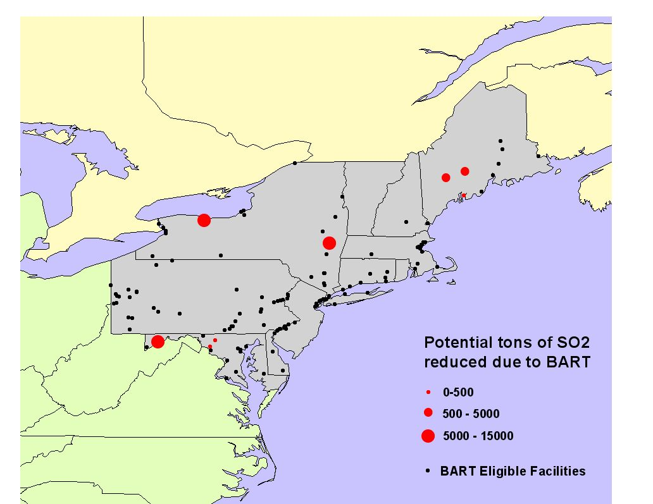
BART Representation in New Modeling
Includes reductions at 8 facilities where BART controls are anticipated due to the BART regulation alone (~33K tpy)
Many other BART-eligible sources are
being controlled under other programs
(e.g. CAIR, MACT, State multi-P programs,
etc. )

Slide 12
MANE-VU EGU Strategy
All MANE-VU States will pursue reasonable NOx and SO2 reductions from all EGU sources identified as being one of the top 100 sources impacting any MANE-VU Class I area* or equivalent reduction of 90% from the “top sources” within that state
*Looking across all MANE-VU sites, there are 167 stacks that fit in this category

Slide 13
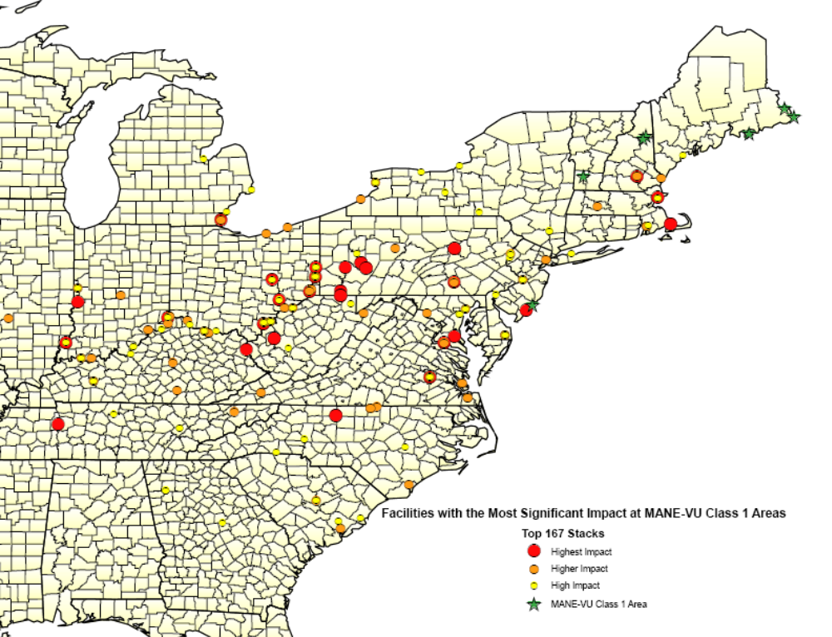
EGU Strategy – “167 Stacks”

Slide 14
Description of EGU implementation
Each MANE-VU state provided comments on the level of reductions that would be feasible for the “167 Stack” facilities or alternate measures that would achieve the ask
These state comments were included on a source-by-source basis in emission files
A final adjustment was made to maintain the CAIR cap

Slide 15
MANE-VU Sulfur-in-fuel Strategy
Low Sulfur Oil – inner zone (NJ, NY, PA)
Low Sulfur Oil – outer zone (rest of M-V)
Strategy | S-1 | S-2
distillate | 500 ppm | 15 ppm
#4 oil | 0.25% sulfur | 0.25% sulfur
#6 oil | 0.3-0.5% sulfur | 0.3-0.5% sulfur
Required no later than | 2012 | 2016
Strategy | S-1 | S-2
distillate | 500 ppm | 15 ppm
#4 oil |  | 0.25% sulfur
#6 oil |  | 0.3-0.5% sulfur
Required no later than | 2014 | 2018

Slide 16
Description of Low-sulfur Fuel Program Implementation in MANE-VU
Identified oil-combustion SCC codes for area, point, mobile inventory in M-V ONLY
Corrected 2018 sulfur content values and implemented levels as proposed
NESCAUM applied control packets in SMOKE processing to ensure reductions were reflected in the modeling
Resulted in significant reductions due to high initial sulfur content

Slide 17
Emissions benefits estimated
EGU benefits within MANE-VU are constrained because of the decision to maintain the CAIR cap for this run (the reductions are all added back)
2018 SO₂ emissions reduction on the order of 211,000 tons from low-sulfur oil strategy
BART would control 8 sources and yield approximately 33,000 tpy
Last two combined: 244,000 tpy or 35% of the MANE-VU 2018 non-EGU SO₂ inventory

Slide 18
MANE-VU Ask
(What are we asking of other contributing states?)
EGU
  require reasonable NOx and SO2 reductions from all EGU sources identified as being one of the top 100 sources impacting any MANE-VU Class I area or equivalent reduction of 90% from these “167 Stacks” within that state
Non-EGU
  28 percent non-EGU SO₂ reduction by 2018
    132,000 tpy from MidWest RPO
    308,000 tpy from VISTAS
We have tried to represent this ask for
both the VISTAS and MidWest RPO
in a reasonable way in our most
recent modeling

Slide 19
How did we represent the MANE-VU Ask in MidWest and VISTAS RPOs? (1)
Comparison of 10% of 2002 “CEMS” emissions (our goal) and projected 2018 emissions at “167 Stacks” (provided by MidWest and VISTAS)
Tons per year | VISTAS | MidWest
10% of 2002 CEMS emissions | 169,816 | 170,454
2018 Projected emissions | 299,090 | 436,138
Additional reductions needed | 129,275 | 265,683

Slide 20
How did we represent the MANE-VU Ask in MidWest and VISTAS RPOs? (2)
Considered Reductions at Other EGUs
  VISTAS: used G2 inventory
  MidWest RPO: Used IPM 2.1.9 inventory
  No further reduction was needed in VISTAS region; over 180K tpy reduction in G2
  Applied additional reductions in MidWest to achieve more than 265K tpy reduction at 65 units
    based on IPM 3.0 projections

Slide 21
How did we deal with CAIR cap?
EGU “Add Back”
  Resulting EGU inventory was significantly below what binding emission caps require
  Roughly 21% SO2 was added back to CAIR EGUs in the modeling domain
  The total SO2 from EGUs in the domain agrees with the total SO2 projected by the Inter-RPO/VISTAS IPM model.
    The distribution reflects the adjustments determined by the consultation process

Slide 22
Model Assumption: Non-EGU Ask
MWRPO & VISTAS: ICI Boilers
  Coal: 60% Reduction
  Oil: 75% Reduction
  Unknown fuel: 50% Reduction
VISTAS only
  Area Source Oil Combustion: 75% Reduction
These measures reflect model representations, not actual implementation
plans for how other RPOs would achieve the targets specified in the
“MANE-VU non-EGU ask.”

Slide 23
National Ask
(What are we willing to consider as part of a national/super-regional program)
EGUs
  11% additional SO₂ reduction beyond full implementation of CAIR by 2018
ICI Boilers
  Commitment to propose ICI boiler regulations to achieve 50% sector average SO₂ reduction by 2013
We have NOT tried to represent
the national ask in this modeling
for any RPO

Slide 24
2018 State Total SO₂ Emissions
(thousand tons per year)
MANE-VU
State Name | OTB/OTW (VISTAS IPM 2.1.9) | Adjusted EGU | Low Sulfur Oil and BART* | As modeled
Connecticut | 22.7 | 0 | -12.2 | 10.5
Delaware | 48.0 | -24.5 | -3.0 | 20.5
District of Columbia | 2.6 | 0 | -1.8 | 0.8
Maine | 47.7 | +1.4 | -27.1 | 22.0
Maryland | 80.6 | +15.7 | -19.4 | 76.9
Massachusetts | 64.4 | +28.5 | -32.8 | 60.1
New Hampshire | 18.8 | +3.3 | -8.5 | 13.6
New Jersey | 52.6 | -16.6 | -9.2 | 26.8
New York | 266.7 | +23.1 | -91.7 | 198.1
Pennsylvania | 304.4 | +35.0 | -28.8 | 310.6
Rhode Island | 8.8 | 0 | -7.1 | 1.7
Vermont | 6.0 | 0 | -2.5 | 3.5
MANE-VU Total | 923.3 | +65.9 | -244.1 | 745.1
*EGU reductions anticipated for Wyman Station in Maine are listed under BART

Slide 25
New Modeling Results

Slide 26
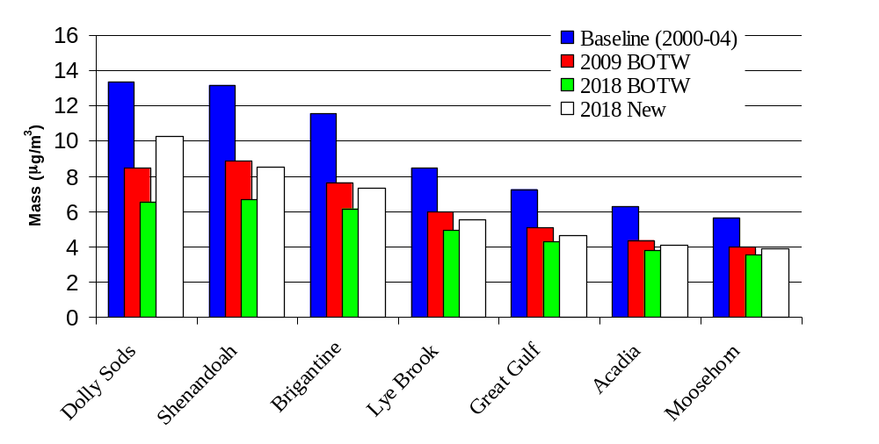
Comparison of Projected Sulfate Mass
20 Percent Worst Days

Slide 27
Caveat
Uncertainties remain in the projection of visibility due to our limited ability to predict the distribution of reductions under CAIR and the implementation of non-EGU controls in other RPOs

Slide 28
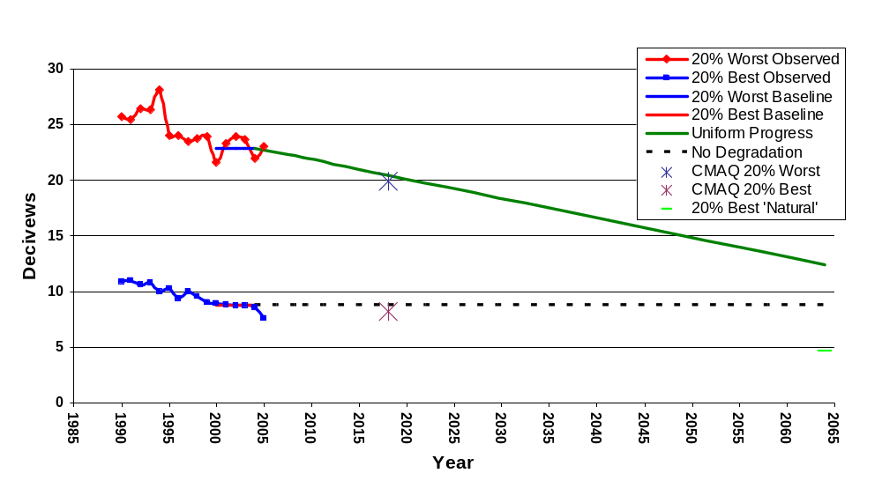
Acadia Glide Path

Slide 29
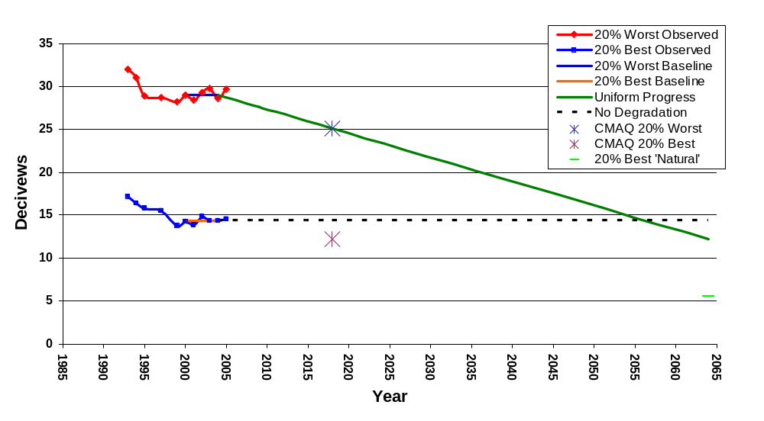
Brigantine Glide Path

Slide 30
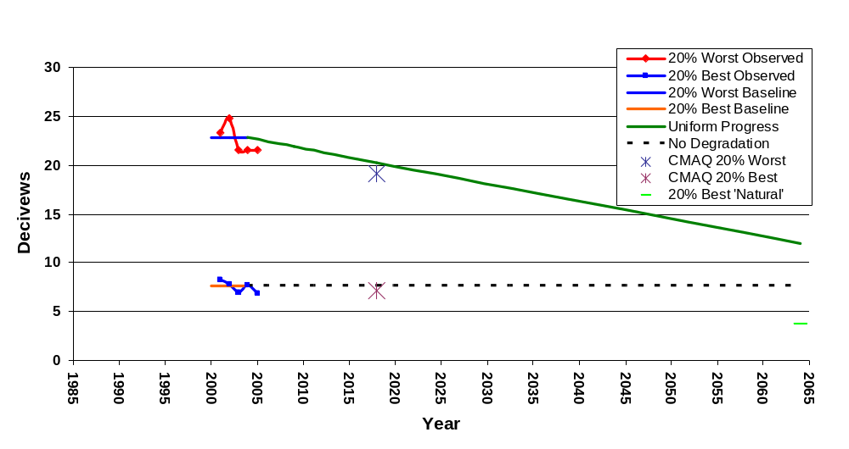
Great Gulf Glide Path

Slide 31
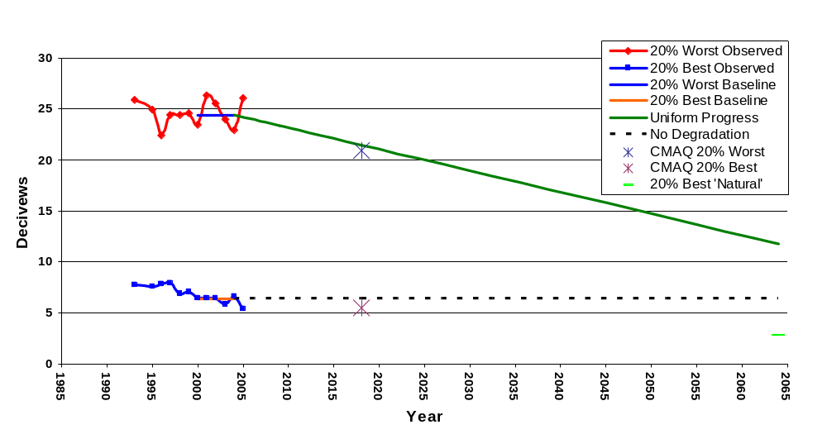
Lye Brook Glide Path

Slide 32
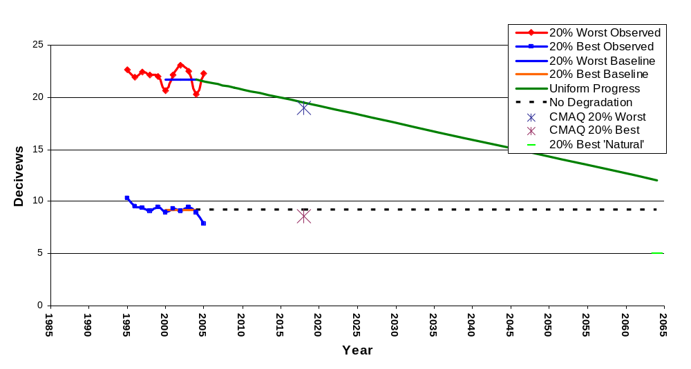
Moosehorn Glide Path

Slide 33
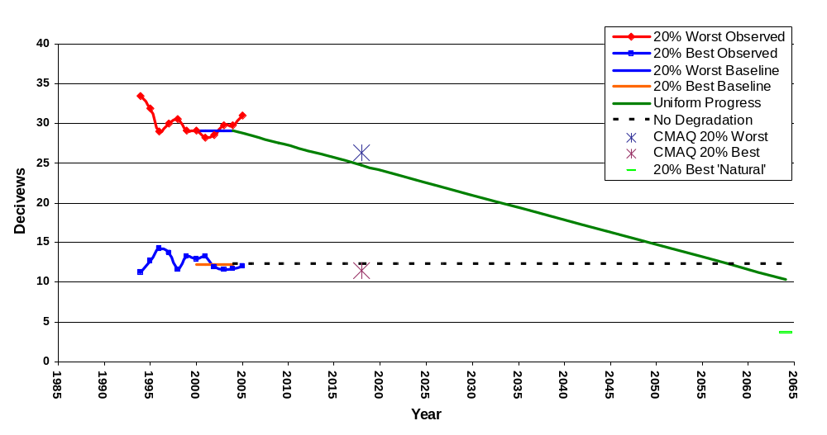
Dolly Sods Glide Path

Slide 34
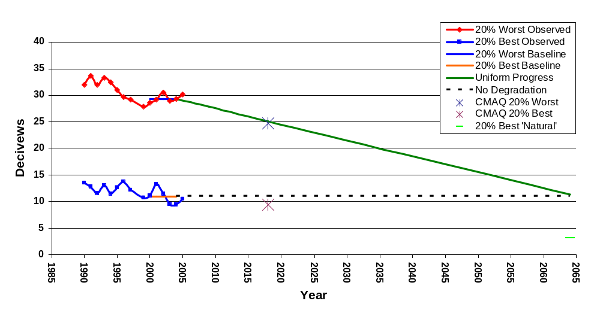
Shenandoah Glide Path

Slide 35
Conclusions
The Uniform Rate is achieved and exceeded at all MANE-VU Class I sites
Redistributing emissions and maintaining the CAIR cap reduces projected benefits
The net effect is less visibility improvement than the earlier sensitivity analysis would have predicted

Slide 36
Conclusions
Additional potential EGU emissions reductions as identified by other RPOs (if we skip the “add back”) would lead to considerably greater visibility benefit (as demonstrated by sensitivity modeling)
A third phase of CAIR would require additional EGU reductions and achieve greater benefit

